Slide 1
Lesson Six
Hydrographs

Slide 2
A hydrograph: is a graph of flow rate versus time
A streamflow hydrograph is composed of both surface runoff and groundwater that has infiltrated into a stream.
Groundwater flow is composed of interflow (fast responding from groundwater areas close to the stream) and base flow (relatively constant over longer time periods).
Many shapes for hydrographs are possible, one such is shown in Figure (1).

Slide 5
The hydrograph consists of three general parts:
Rising limb or concentration curve
Crest segment or peck discharge
Recession curve or falling limb

Slide 6
A runoff hydrograph will have at least the following properties:
Lag time (L): the time interval from the center of mass of the rainfall excess to the peak of the resulting hydrograph.
Time to peak (t_{p}) : the time interval from the start of rainfall excess to the peak of the resulting hydrograph.
Time of concentration (t_{c}) : the time interval from the end of rainfall excess to the inflection point (change of slope) on the recession curve. Also, the longest time for water to flow to a discharge point from any point in the watershed.
Recession time (t_{r}): time from the peak to the end of surface runoff.
Time base (t_{b}): time from the beginning to the end of surface runoff.

Slide 7
Hydrograph Records
Since most of the printed records report flow rates on a daily basis, most hydrographs for large watersheds are reported on a daily basis.
If the rainfall excess passes from the watershed in less than a day, the hydrograph must reflect a time scale in hours or possibly minutes.
The mean (arithmetic average) daily discharge is a representation of flow from midnight to midnight.

Slide 8
Mathematical Description of Hydrograph Shape
Assumption: The watershed outflow rate is a linear function of storage.
This method has been referred to as a single linear reservoir model.
It appears to be appropriate for small watersheds and rainfall events of short duration.

Slide 9
Mathematical Description of Rising Limb
For the rising limb of a hydrograph, a mathematical description can be developed using a mass balance equation with generation equal to zero:
Input – Output ± generation = accumulation
where
r = rainfall excess rate (ft³/sec)
Q = outflow rate (ft³/sec)
S = storage for rainfall excess (ft³)
t = time frame for analysis (sec)
1

Slide 10
Mathematical Description of Rising Limb
Assuming an approximate linear relationship exists as shown in fig. 6.6 between outflow rate and storage.
where
S = storage volume (ft³)
Q = outflow rate (ft³/sec)
K = Storage coefficient (sec⁻¹)
and in differential form
2
3

Slide 11
Mathematical Description of Rising Limb
Substituting for dS from Equation 3 into equation 1 result in
Integration of Equation 4 when t=0 and Q=0 results in
4
5

Slide 12
Mathematical Description of Rising Limb
Equation of 5 is valid only for the rising of a hydrograph developed using a linear relationship between storage and outflow rate.
As long as rainfall excess and stream flow data are available, the appropriate K (storage coefficient) can be estimated to fit the rising limb of the hydrograph.
Q
K
S

Slide 13
Hydrograph Groundwater Flow Separation (Recession Limb)
The recession limb of a streamflow hydrograph has been analyzed because it results from both surface runoff and groundwater flows.
By subtracting groundwater flow rates from the stream hydrograph, an estimate of the runoff hydrograph and effective rainfall for the watershed and rainfall conditions is possible.
Since groundwater flows are determined by both long-term and short-term groundwater storage, the groundwater portion of the recession limb is most likely a combination of groundwater flows resulting from many previous rainfall events.

Slide 14
Hydrograph Groundwater Flow Separation (Recession Limb)
Since both surface and groundwater flows will be directly related to surface and groundwater storage, assume the following differential relationship:
where
S = storage volume (L³)
K′ = storage coefficient, most likely a composite of 2 or 3 coefficient (t⁻¹)
Q = outflow rate (L³/t)
6

Slide 15
Hydrograph Groundwater Flow Separation (Recession Limb)
Equation 8 is analogous to a storage tank (watershed) losing its water at an exponential rate as shown in fig. 6.7.
Q
Q_{p}
Time (t_{r})
Figure 6.7 The recession curve analogy to a storage tank

Slide 16
Hydrograph Groundwater Flow Separation (Recession Limb)
The storage coefficient (recession coefficient) is rarely constant over the entire recession curve.
Groundwater flows into a stream depend on the soil types at different locations.
Other flows depend on the elevation relationship (head) of the groundwater water table to the stream surface over a very long period of time (base flow). Thus, it is more accurate to represent the recession curve by a composite exponential, or
where Q_{i} = intercept for any segment i at t_{r} = 0 (cfs)
= slope for any segment I (1/time) storage coeff.

Slide 17
Hydrograph Separation
There are several methods to separate groundwater contribution from total hydrograph, including:
Simply by drawing a line AC tangential to both the limbs at their lower portion.
Extending the recession curve existing prior to the occurrence of the storm up to the point D directly under the peak of the hydrograph and then drawing a straight line DE, where E is a point on the hydrograph N days after the peak, and N (in days) is given by:

Slide 18
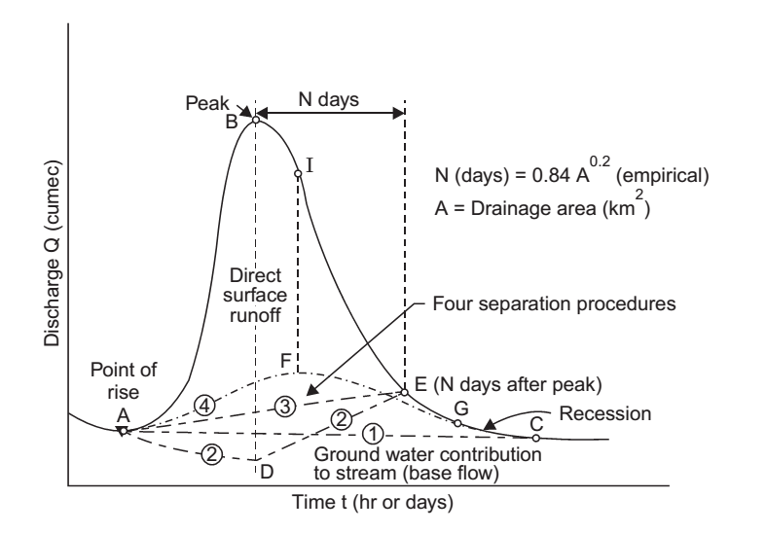
Hydrograph Separation

Slide 19
Hydrograph Separation
Simply by drawing a straight line AE, from the point of rise to the point E, on the hydrograph, N days after the peak.
Construct a line AFG by projecting backwards the groundwater recession curve after the storm, to a point F directly under the inflection point of the falling limb and sketch an arbitrary rising lines form the point of rise of the hydrograph to connect with the project base flow recession. This type of separation is preferred where the groundwater storage is relatively large and reaches the stream fairly rapidly, an in limestone terrains.

